Slide 1

DIAGNOSIS OF SPINAL LUMBER DEGENERATION USING DEEP LEARNING
By
Hariom Kumar Ray
(B.Tech 4th Year, Enrollment No.:12021002001066)
Priyanshu Ghosh Chowdhury
(B.Tech 4th Year, Enrollment No.:12021002001078)
Under the Supervision of
Prof. Dr. Tapas Si
Dept. of Computer Science & Engineering
University of Engineering & Management, Jaipur

Slide 2
Outlines
Introduction
Literature Review
Proposed Model
Objectives
Experimental Setup
Result
Result Analysis
Conclusion & Future Scope
Bibliography

Slide 3
Introduction
Lumbar spine degeneration is a condition that affects the lower back and is often associated with aging, lifestyle factors, and injuries. It can lead to chronic pain, reduced mobility, and complications like nerve compression, making it a significant concern for patients and healthcare providers.
This project focuses on using artificial intelligence and Machine Learning to simplify and enhance the diagnostic process. By applying deep learning techniques, such as PyramidNet for feature extraction, and YOLO for pinpointing areas of degeneration, we aim to develop an automated system that is fast, accurate, and reliable.
With the potential for real-time analysis and application in both urban and remote healthcare settings, this project represents a step forward in integrating AI into medical imaging and improving overall patient care.

Slide 4
Literature Review
Chunyang Xu, Xingyu Liu, Beixi Bao, chang Liu published a pape on Two-Stage Deep Learning Model for Diagnosis of Lumber Spondylolithesis Based on Lateral X-Ray Images achieving an accuracy upto 92.3% using YOLOv8 model network.
The developed model is significantly enhanced from the previous conference version both in terms of kernel of CNN for feature extraction and the receptive fields. The specific architecture of the developed Pyramid-CNN models is presented in Fig. 1. Three feature extraction blocks in the form of 1D convolutional layers with decreasing kernels size can be seen in Fig. 1. In the revised model, the MaxPooling layer is added before the Rectified Linear Unit (ReLU) layer, which decreases the spatial dimension (feature maps).
In 2020 Demir etal used a novel feature generation model called as exemplar pyramid for classification of humeral fracture and achieved an accuracy of 99.12%.

Slide 5
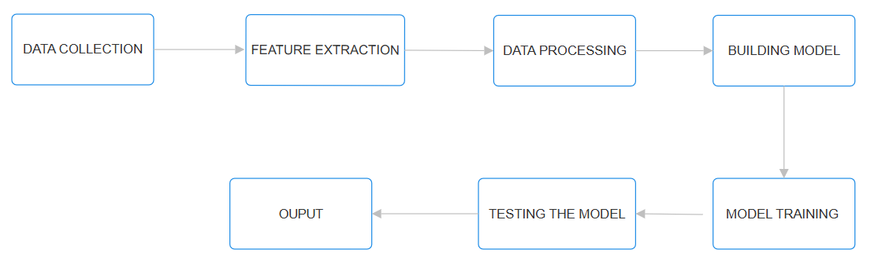
Proposed Model
FIG: Proposed Model

Slide 6
Objectives
The main objective of this project is to develop an automated system for diagnosing lumbar spine degeneration using deep learning techniques.
The goal is to accurately analyze medical images like X-rays and MRIs, identify signs of degeneration, and classify its severity and predict the accuracy, By integrating models such as PyramidNet and YOLO, the project aims to provide a reliable, fast, and precise tool that supports healthcare professionals in making informed decisions.
This system is designed to address the challenges of traditional diagnostic methods, such as time consumption and human error, by automating the process.
It seeks to reduce the burden on radiologists, ensure consistent results, and enable quicker treatment for patients.
By applying deep learning techniques, such as PyramidNet for feature extraction, CNNs for classifying the condition, and YOLO for pinpointing areas of degeneration, we aim to develop an automated system that is fast, accurate, and reliable.

Slide 7
Experimental Set-up
Software Requirements:
Python: The primary programming language for this project, employing libraries like Pandas, NumPy, Matplotlib, Seaborn, Pydicom and YOLO for data manipulation, analysis, visualization, and machine learning model development.
Jupiter Notebook and Kaggle Notebook : For coding, executing, and documenting the project workflow.
Specifically, for implementing YOLO(You Only Look Once) requires addressing both the image classification and localization tasks inherent in YOLO.
Modules Used:
Pandas and NumPy: For data preprocessing and manipulation.
Pydicom: for data imaging and communication in medicine.
Matplotlib and Seaborn: For data visualization and plotting.
YOLO: used for real-time object detection and classification.

Slide 8
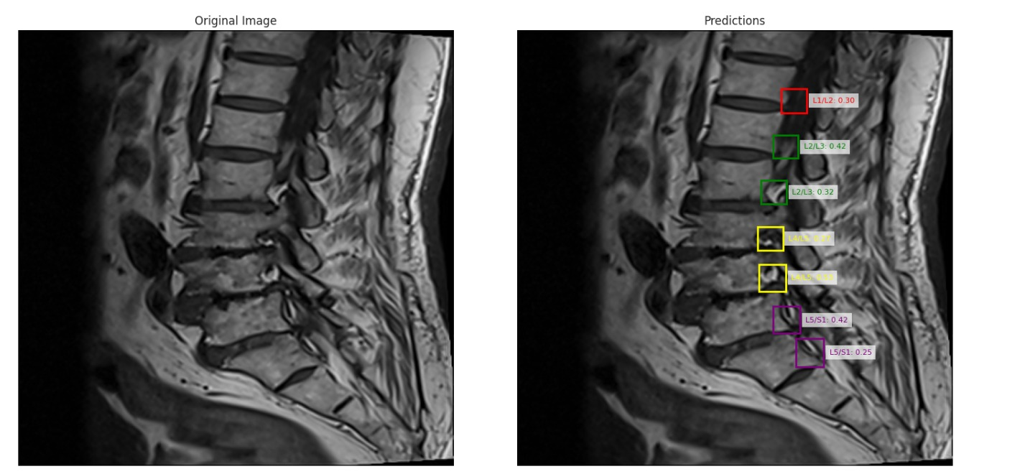
Result

Slide 9
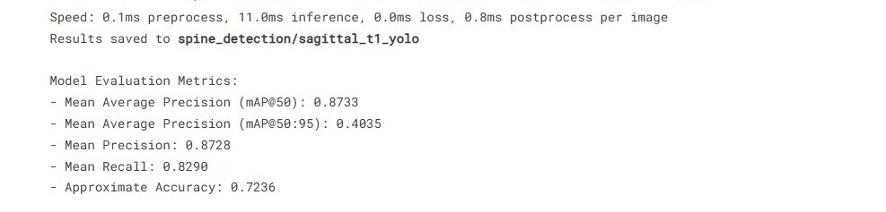

Slide 10
Result Analysis
The developed system, combining PyramidNet, CNNs, and YOLO, achieved high accuracy in detecting degenerative changes in medical images like X-rays and MRIs.
The high accuracy and localization performance make this system a valuable tool in medical imaging, potentially improving patient outcomes and reducing diagnostic errors. Additionally, the system's scalability ensures its applicability in various clinical settings, from advanced hospitals to remote healthcare centers.
The automation offered by this system significantly reduced the time required for diagnostic analysis compared to traditional manual evaluation methods.
The YOLO model, integrated for localization, performed exceptionally well in detecting and marking affected regions in the spine, such as intervertebral discs or vertebrae showing degenerative changes.

Slide 11
Limitation
Data Dependency: Deep learning models require large, high-quality datasets for training. In medical imaging, obtaining such datasets is challenging due to privacy concerns, limited availability of labeled images, and variability in image quality across institutions.
Overfitting Risk: If the dataset is not sufficiently diverse, the model may overfit to the training data, performing poorly on unseen cases.
Limited Multimodal Integration: Current models often rely on a single imaging modality, such as X-rays or MRIs, rather than integrating information from multiple sources, which could enhance diagnostic accuracy.

Slide 12
Conclusions & Future Scope
By combining models like PyramidNet, CNNs, and YOLO, the system accurately identifies and locates degenerative changes in medical images such as X-rays and MRIs.
The high accuracy and precision of the system show that AI can be a valuable tool in helping healthcare professionals make faster and more reliable diagnoses.
The model depends on large, high-quality datasets and might struggle with generalizing across different patient groups or imaging equipment.
In future we are thinking of add more features and models to make it more accurate.
In the future, it’s also possible to develop this system into a real-time diagnostic tool that works directly with healthcare providers in hospitals, clinics, and even remote areas.
Another opportunity is integrating multiple types of imaging data, such as CT scans or even patient medical history, to create a more comprehensive diagnostic tool.

Slide 13
References
Deep Pyramidal Residual Network – Dongyoon Han, Jiwhan Kim, Junmo Kim. https://doi.org/10.48550/arXiv.1610.02915
Wang, L., et al. (2020). "Deep learning-based image analysis for spinal disease diagnosis." Medical Image Analysis, 58, 101579.
A Pyramid-CNN Based Deep Learning Model for Power Load Forecasting of Similar-Profile Energy Customers Based on Clustering - Khursheed Aurangzeb, Musaed Alhussein, Kumail Javaid, Syed Irtaza Haider.

Slide 14

Dept. of CSE, University of Engineering & Management Jaipur

